Slide 1
User Verification Suite: Functionality Overview
This presentation outlines the features and functional flow of our new interactive User Verification Suite. Built with modern web technologies, it guides users through a secure, step-by-step identity verification process.

Slide 2
Overview of the User Verification Suite
The User Verification Suite is an interactive web page designed to streamline identity verification. It emphasizes clarity, responsive layout, and real-time progress tracking to ensure a smooth user experience.
Key Technologies
Verification Steps
React (via CDN)
Email verification
Tailwind CSS (for styling)
Phone number verification
Lucide Icons (for visual indicators)
Aadhaar document verification

Slide 3



Functional Flow: Initial Steps
Welcome Screen
Email Verification
Phone Number Verification
Displays an introductory message and a "Start Verification" button, leading to Email Verification.
User enters email. "Send Verification Email" simulates verification, shows a toast, and proceeds to Phone Verification.
User inputs phone number. "Send OTP" simulates verification, shows confirmation, and advances to Aadhaar Document Upload.

Slide 4
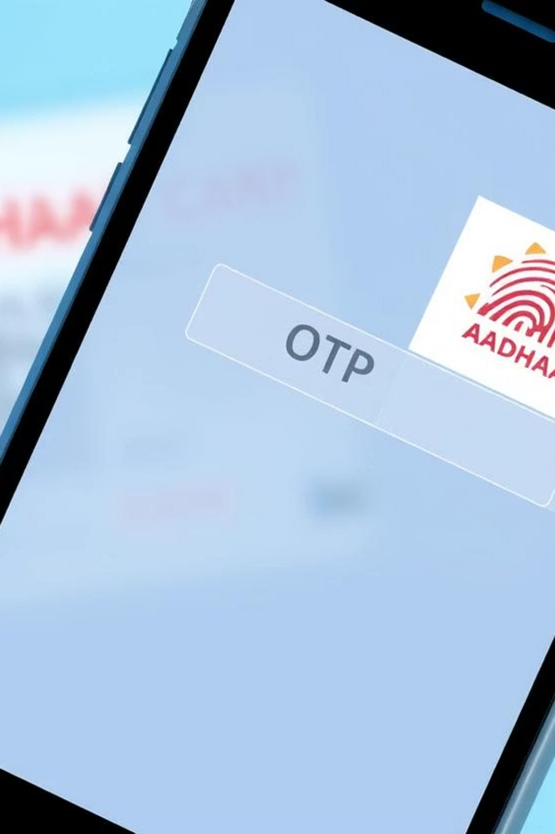
Functional Flow: Aadhaar Verification
Aadhaar Document Upload
User uploads a PDF or image of their Aadhaar. "Scan & Continue" mocks OCR, filling a sample Aadhaar number, and moves to Aadhaar-linked Mobile Verification.
Aadhaar Mobile Verification
Displays the scanned Aadhaar number (read-only). User enters their Aadhaar-linked mobile number. "Send OTP" advances to OTP verification.
Aadhaar OTP Verification
User inputs the OTP. "Verify" marks Aadhaar as verified and displays a success toast.

Slide 5
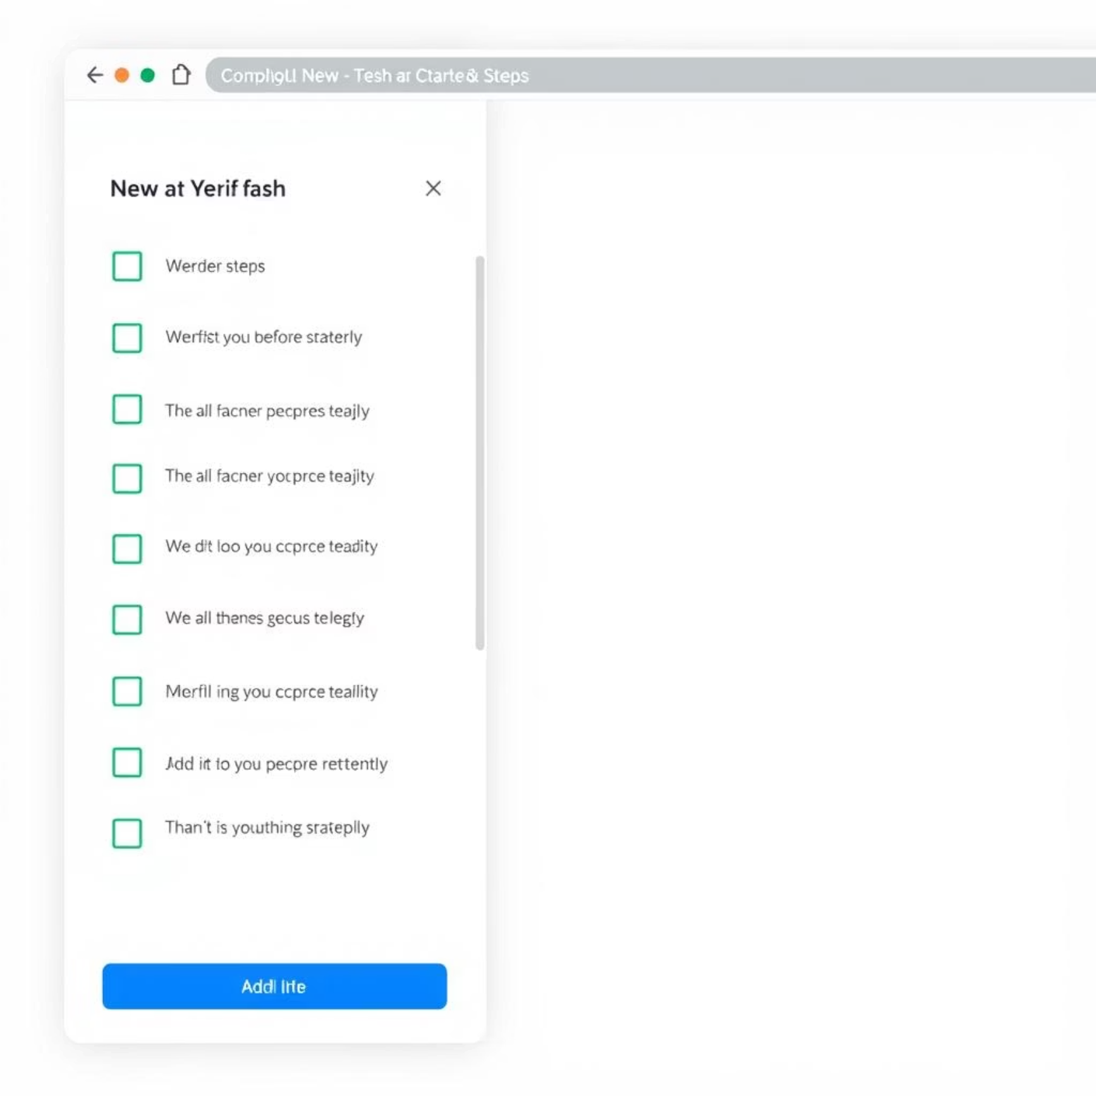
Sidebar Navigation & Progress Tracking
Sidebar Features
View Uploaded Documents
Lists all verification steps: Email, Phone, Aadhaar.
The sidebar also includes a "View Uploaded Documents" section, providing a placeholder for files uploaded during the verification process, such as the Aadhaar document.
Shows completed status with a green check mark for each step.
Highlights the current active step for user guidance.
Allows users to click and navigate between completed steps.

Slide 6




Visual & User Experience Features
Animations
Toast Notifications
Content changes are enhanced with smooth fade-in and slide-up transitions for a dynamic user experience.
Brief, non-intrusive toast messages confirm successful verifications, providing immediate feedback to the user.
Progress Completion Banner
Theme Toggle Button
Upon completion of all verification steps, a prominent "Profile Verified" badge appears, celebrating the user's success.
A convenient button allows users to toggle between light and dark modes, enhancing readability and personalization.

Slide 7
Core Technologies Utilized
The User Verification Suite is built upon a robust stack of modern web technologies, ensuring a responsive, efficient, and visually appealing application.
React
Powers component logic and state management, providing a dynamic user interface.
Tailwind CSS
Enables utility-first styling, allowing for rapid and consistent design implementation.
Lucide Icons
Provides a library of crisp, scalable icons for clear visual indicators.
Babel
Handles in-browser JSX compilation, ensuring compatibility and smooth execution.

Slide 8
Example Usage & Next Steps
User Journey
Key Takeaways
User visits the page and initiates the verification process.
The suite offers a seamless and secure identity verification experience.
Each step is completed sequentially, guided by the interface.
Upon finishing, their profile is marked as verified.
Modern technologies ensure performance and maintainability.
Users can revisit steps or view uploaded documents as needed.
Intuitive UX features enhance user satisfaction.

